Slide 1


HOSTEL
ACCOMODATION SYSTEM
Submitted To
Submitted By
Manish Kumar (18134501019)
Mohd Monis (18134501020)
Mr. Vijay Prakash Bijlwan

Slide 2

CONTENT
01 Introduction
04
Administrator Login
02
Login Portal
05
Student login
03 Home
06
Conclusion

Slide 3


Introduction
As the name specifies “HOSTEL ACCOMMODATION SYSTEM” is a software developed for managing various activities in the hostel.
For the past few years, the number of educational institutions are increasing rapidly.
Thereby the number of hostels are also increasing for the accommodation of the students studying in the institution.
And hence there is a lot of strain on the person who are running the hostel and software is not usually used in this context.
This particular project deals with the problems on managing hostel and avoids the problems which occur when carried manually.
Hostel Accomodation System

Slide 4

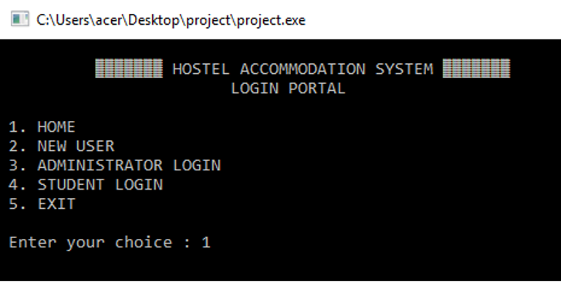

Login Portal
Home
New User
Administrator Login
Student Login
Exit

Slide 5
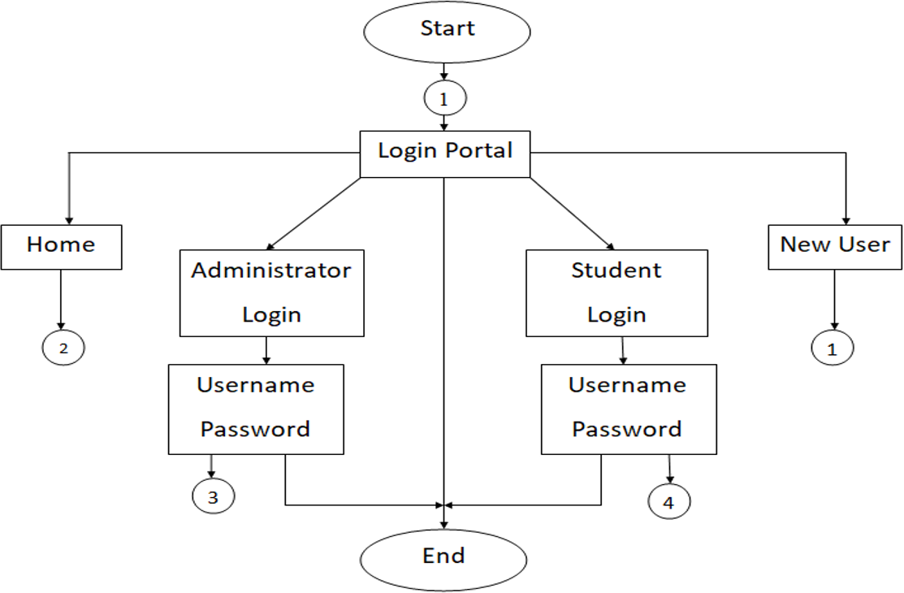
Login Portal

Slide 6
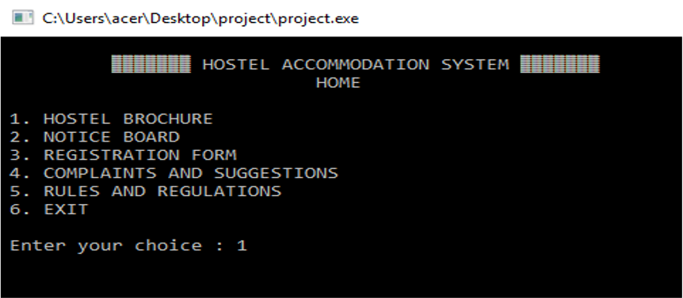


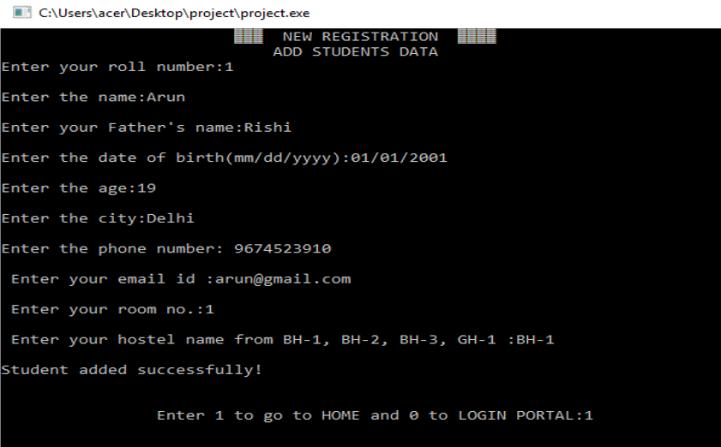
HOME
Hostel Brochure
Notice Board 3.Registration Form
Complaints & Suggestions
Rules & Regulations
Exit

Slide 7
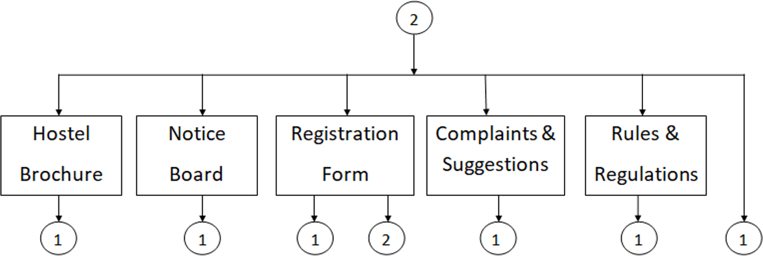
HOME

Slide 8

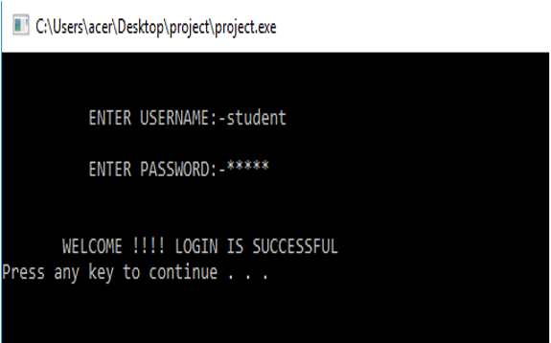
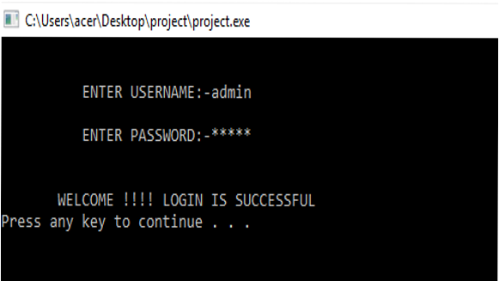






LOGIN
Student login
Admin login

Slide 9
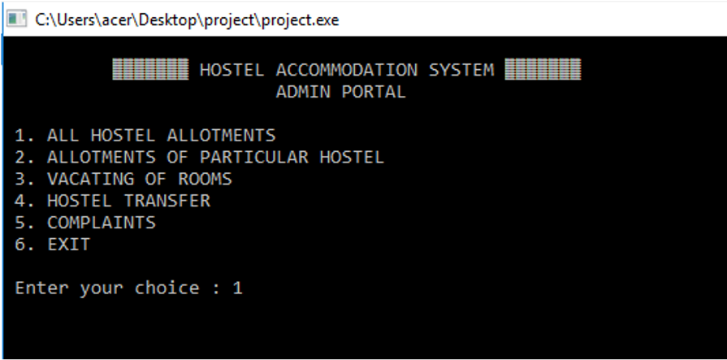
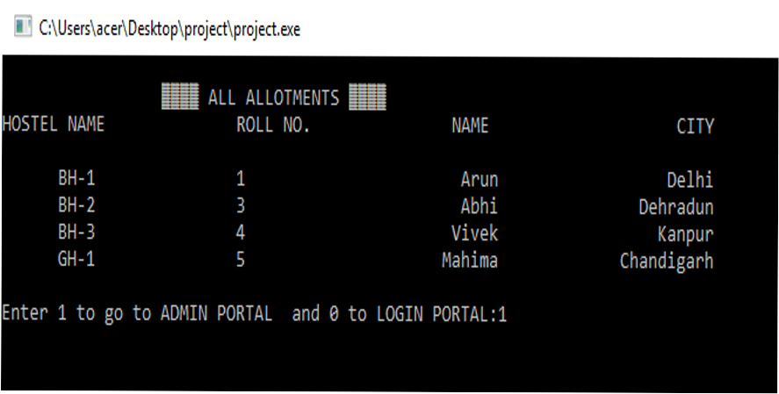
ADMINISTRATOR LOGIN
All hostel allotments
Allotments of particular hostel
Vacating of rooms
Hostel transfer
Complaints 6.Exit

Slide 10
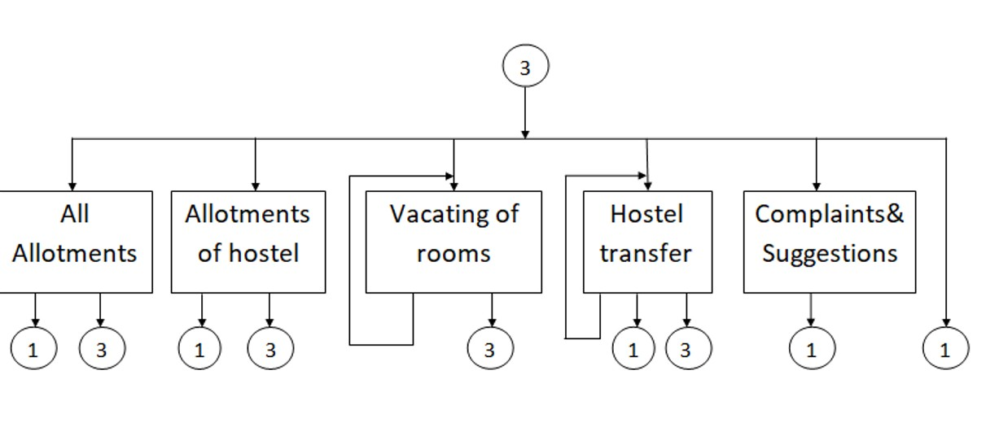
Administrator Login

Slide 11
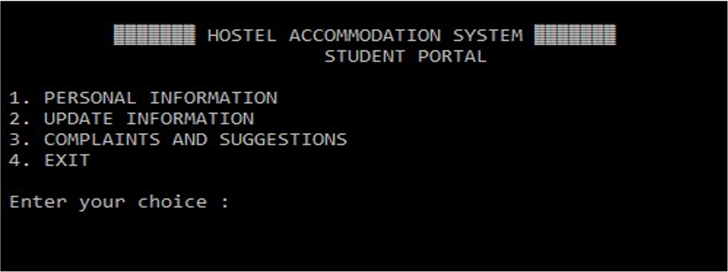
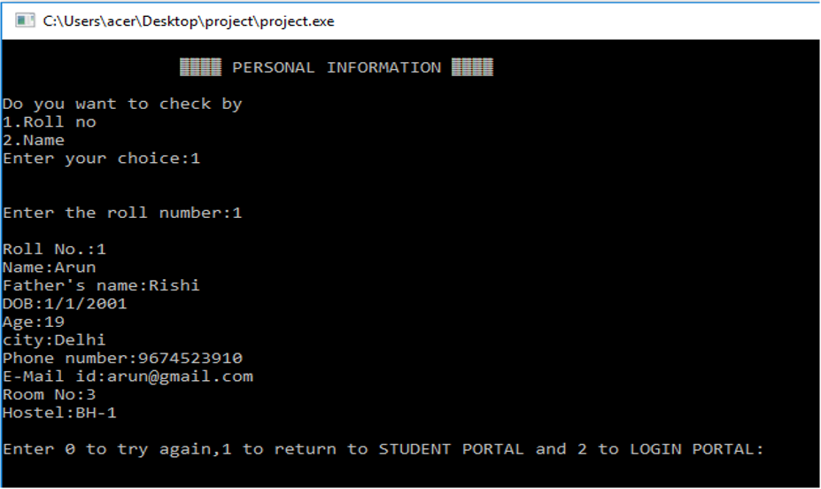
STUDENT LOGIN
Personal Information
Update Information 3.Complaints and
Suggestions
4.Exit

Slide 12
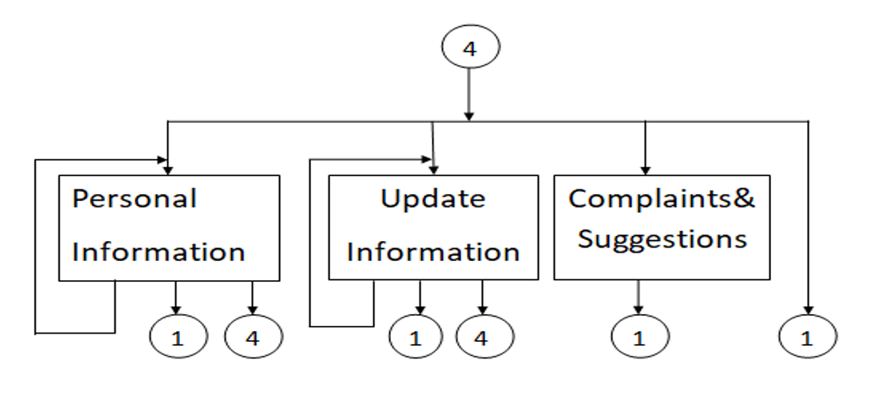
Student Login

Slide 13

Conclusion
The project, developed using 'C Language' is based on the requirement specification of the user and the analysis of the existing system, with flexibility for future enhancement.
Identification of the drawbacks of the existing system leads to the designing of computerized system that will be compatible to the existing system with the system which is more user friendly.

Slide 14

Thank You So Much !!
Manish kumar
mankum2211@gmai.com
Mohd Monis
monishshaikh2021@gmail.com

